Slide 1
vytality fitness
Creators:
Greg Bastien
Hung Nguyen

Slide 2
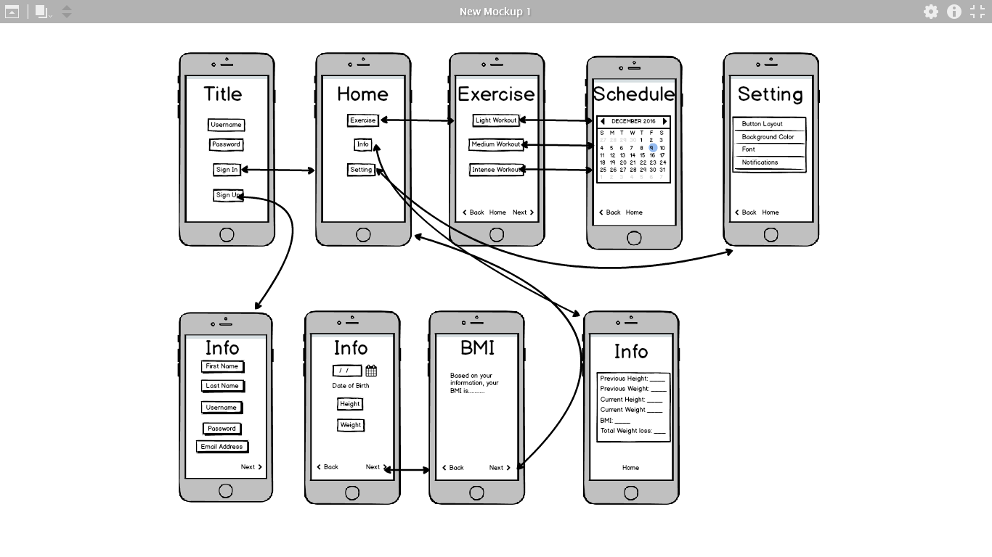
In the beginning….

Slide 3
Goals
To help prevent obesity
To reduce the rate of heart diseases
To improve people’s lifestyles

Slide 4
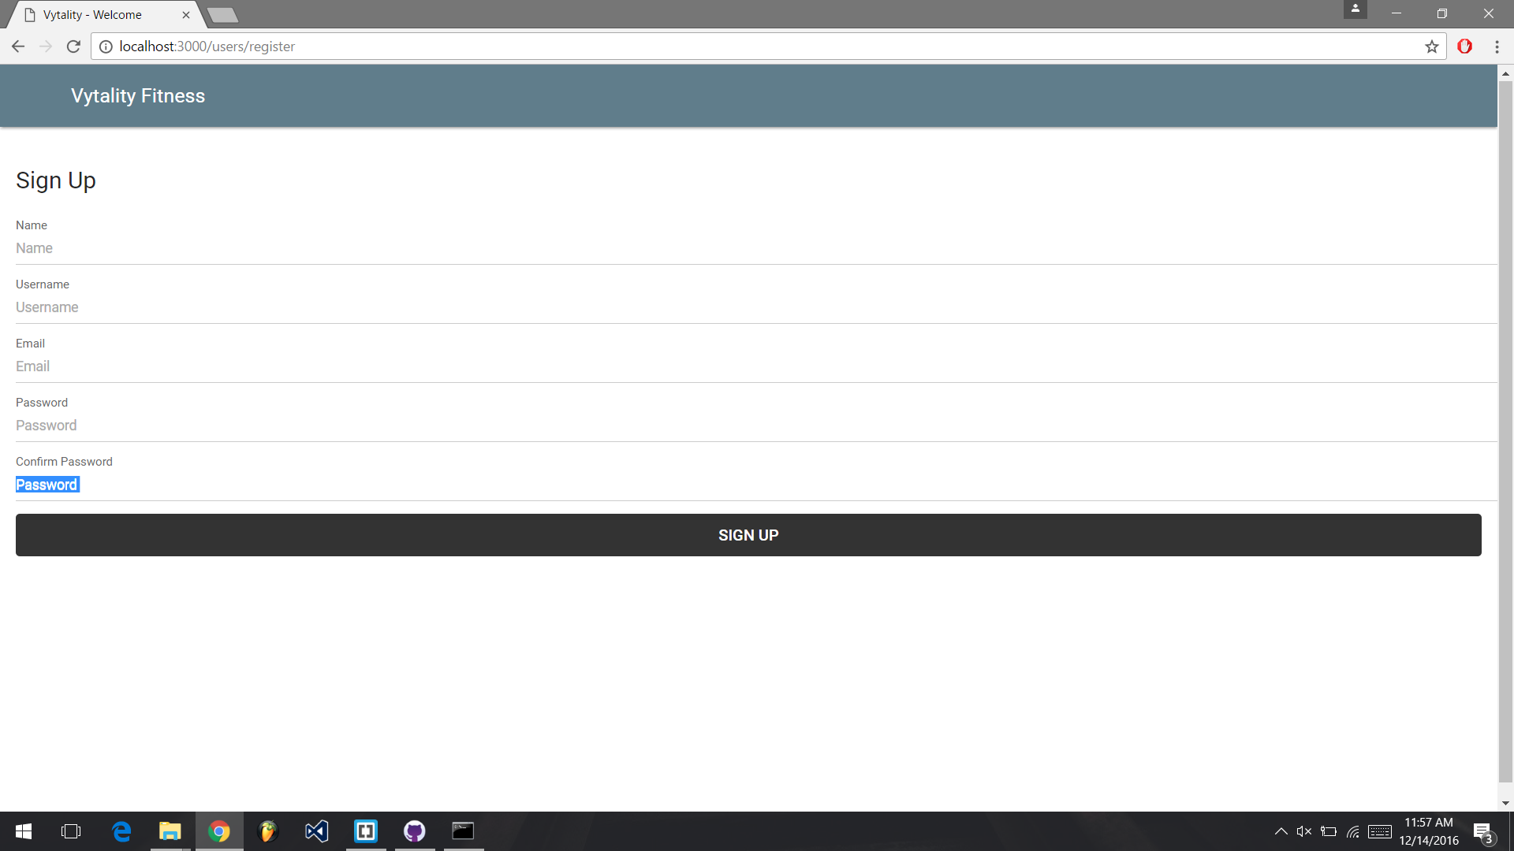
Sign up

Slide 5
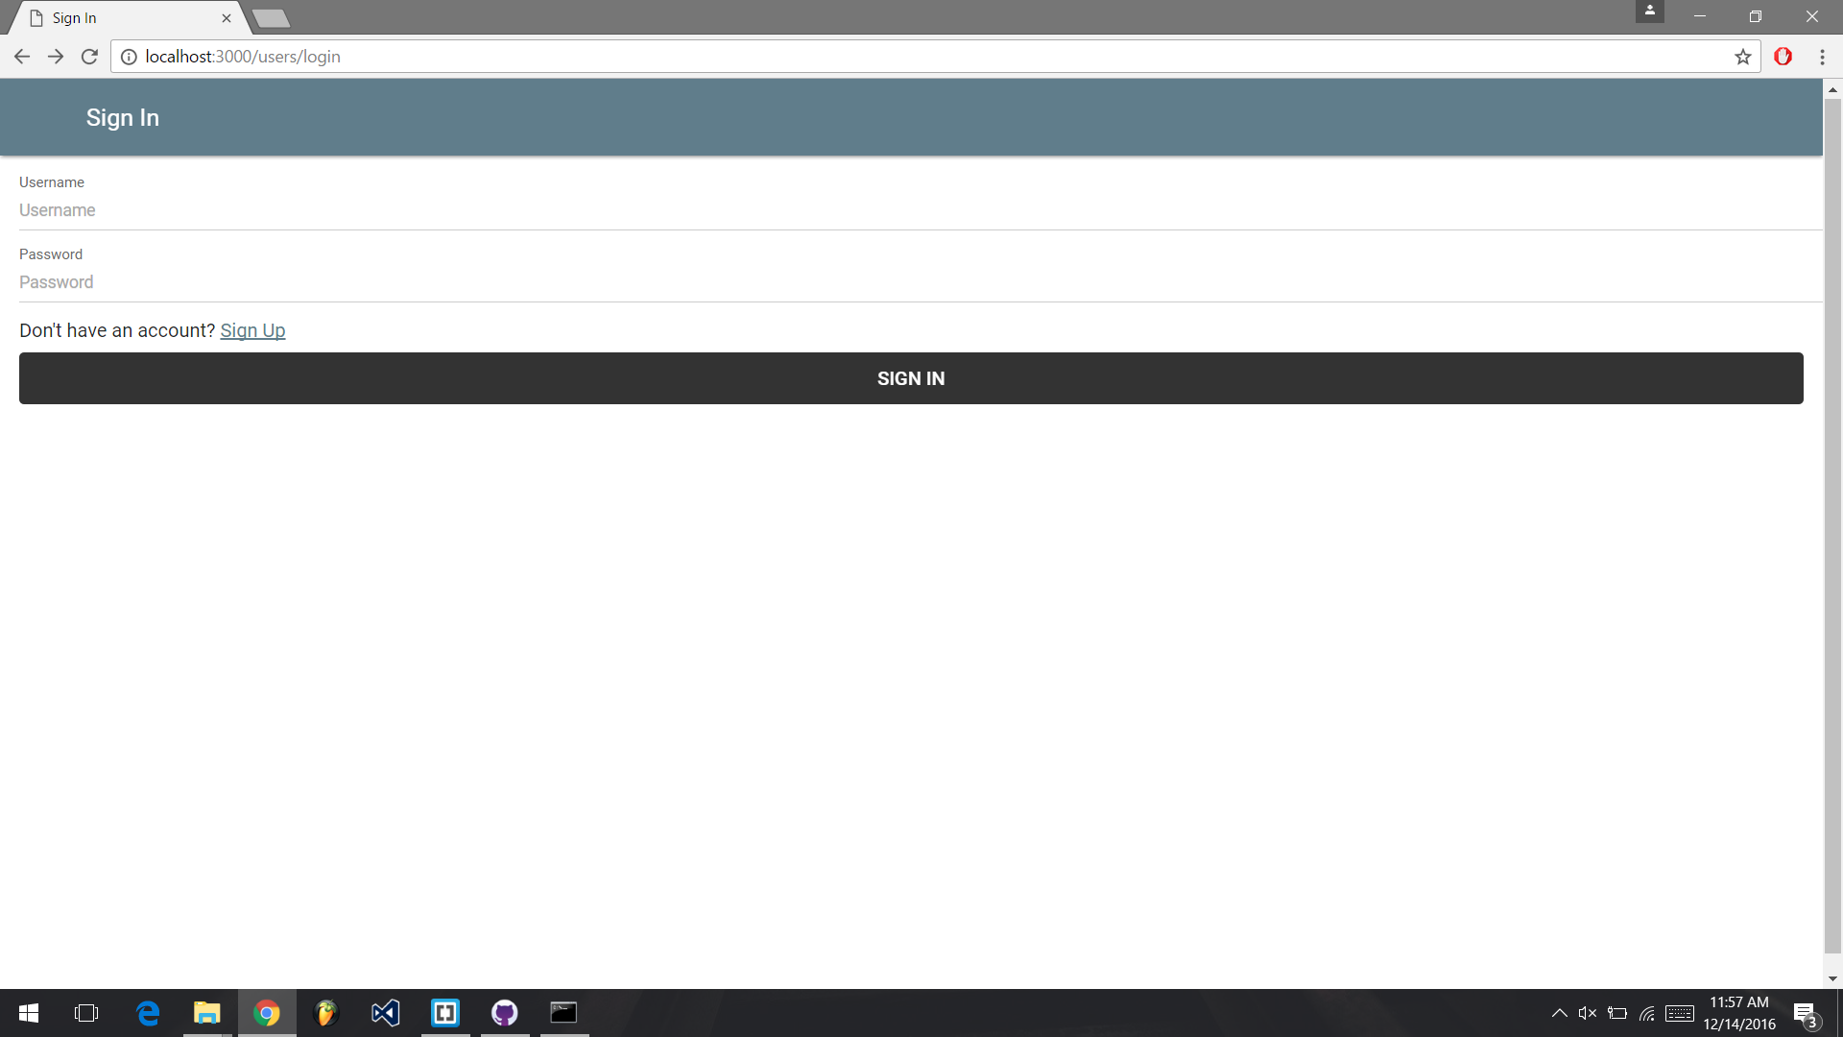
Login

Slide 6
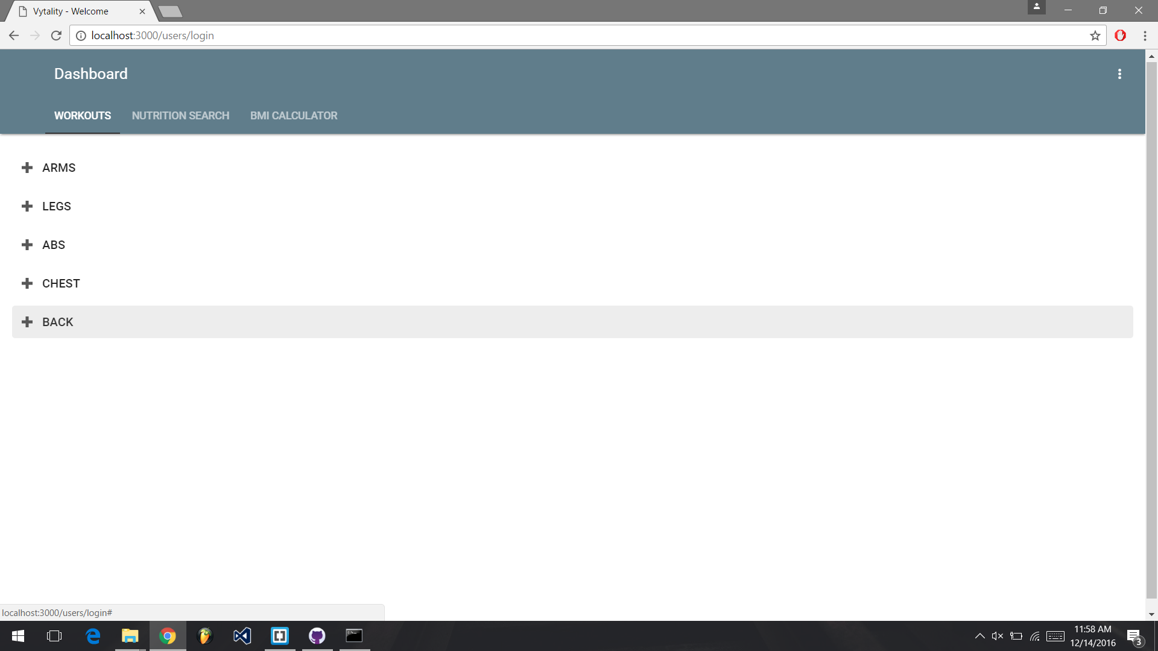
Exercises

Slide 7
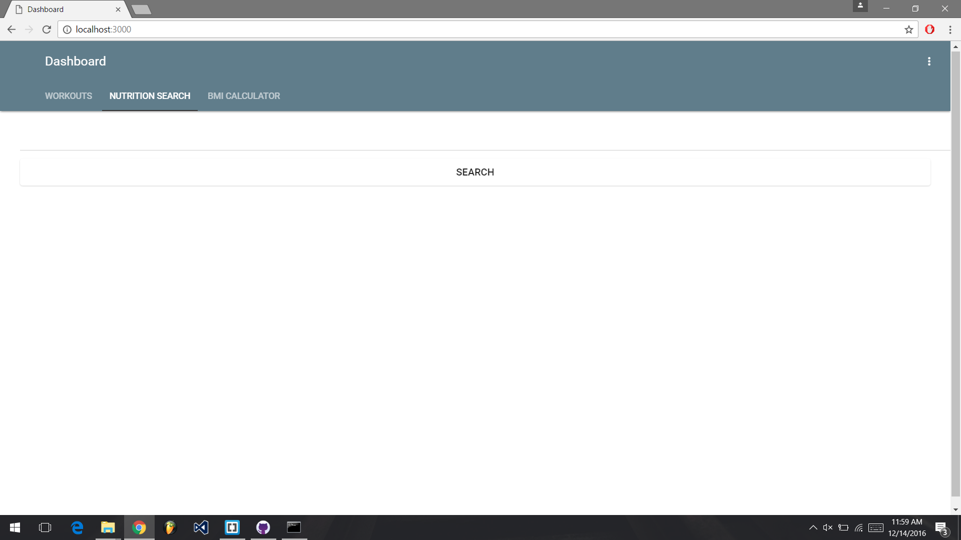
Nutrition

Slide 8
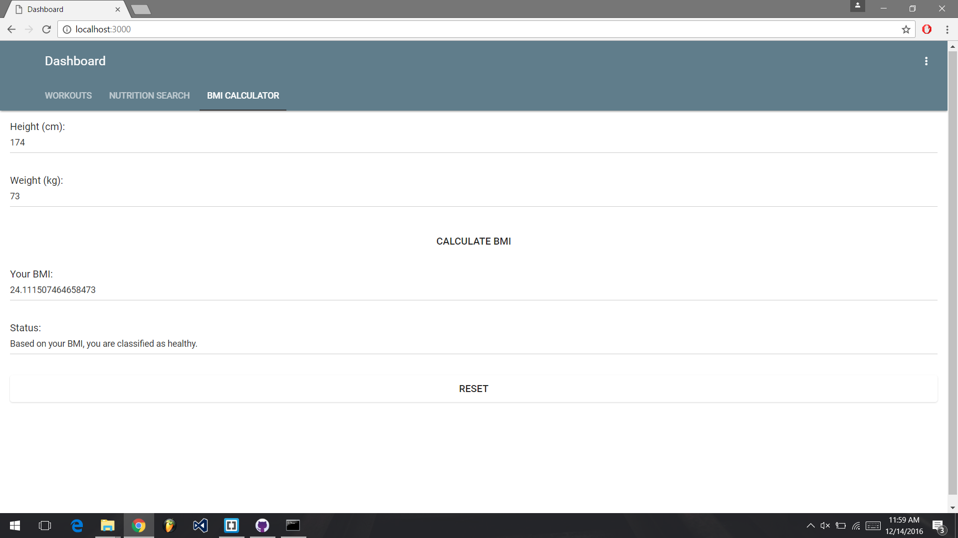
Calculating BMI

